Slide 1

High Impact Skills Development Program
in Artificial Intelligence, Data Science, and Blockchain
Module 3: Data Visualization
Lecture 5: Analyzing Common Visualizations
Interactivity in Visualization
Instructor: Dr. Arham Muslim
Assistant Professor, SEECS, NUST

Slide 2

Lecture 3 – Recap
Building Blocks: Marks and Channels
Expressiveness Principle
Effectiveness Principle
How? – Encoding Vis
Tables: Keys, Values, and Levels
Scatterplot
Bar Chart
Dot Chart
Line Chart

Slide 3

Today’s Agenda
How? – Encoding Vis
Tables: Keys, Values, and Levels
Idioms: Heatmap,
Spatial Axis Orientation
Idioms: Pie Chart, Polar Area Chart, Radar Chart
Networks and Trees
Node-Link Diagrams, Treemaps
Interaction in Visualization
Manipulate (change)
Facet (split)
Reduce items/attributes

Slide 4
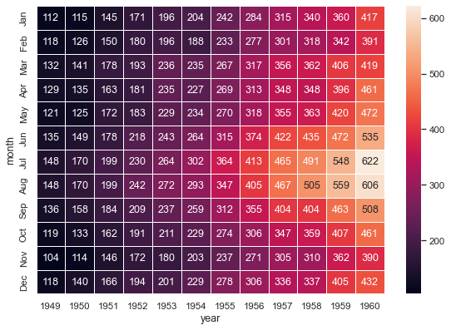
Idiom: Heatmap
Data
2 categ/ordinal key attribs , 1 ordered value attrib
Marks
Area
Channels
Spatial regions: One per mark
Separate and align in 2D matrix
Color luminance
Task
Find clusters, outliers

Slide 5
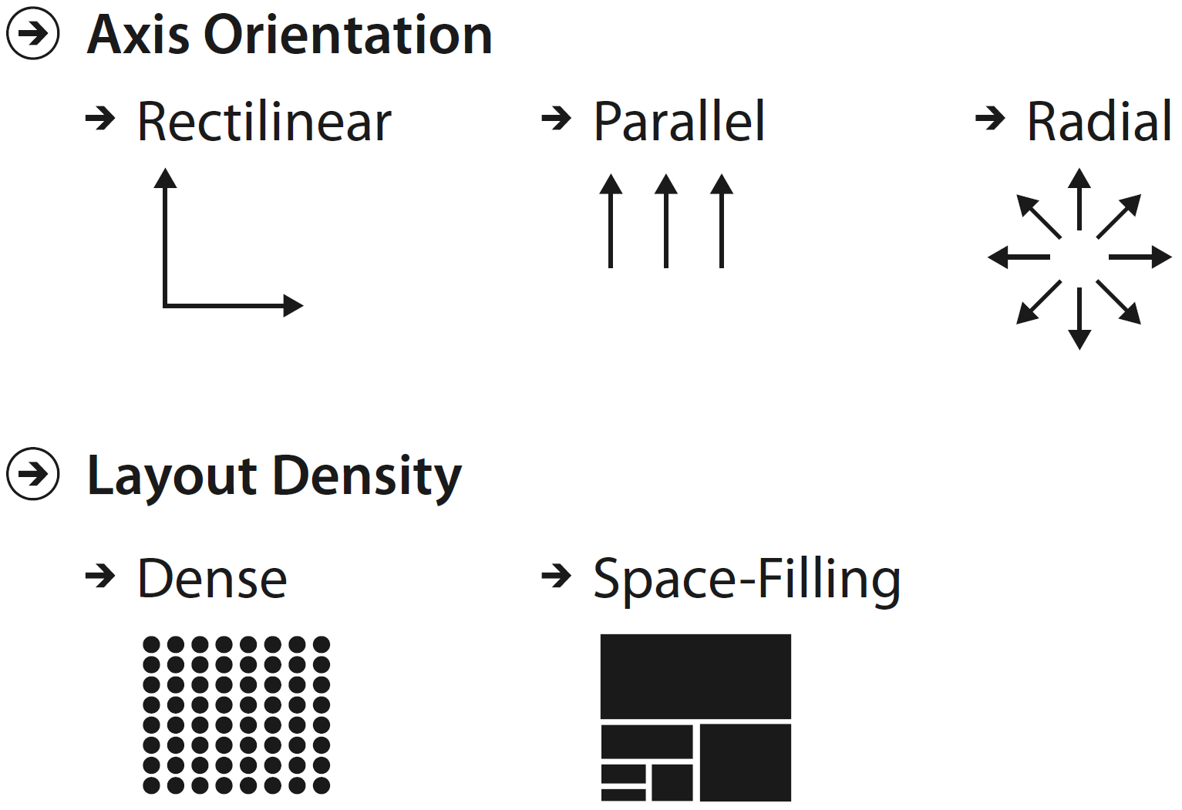
Spatial Axis Orientation
Rectilinear layouts
Regions or items are distributed along two perpendicular axes, horizontal and vertical spatial position
Radial layouts
Items are distributed around a circle using the angle channel in addition to one or more linear spatial channels
Parallel layouts
Parallel layouts are used to visualize many quantitative attributes at once using spatial position

Slide 6
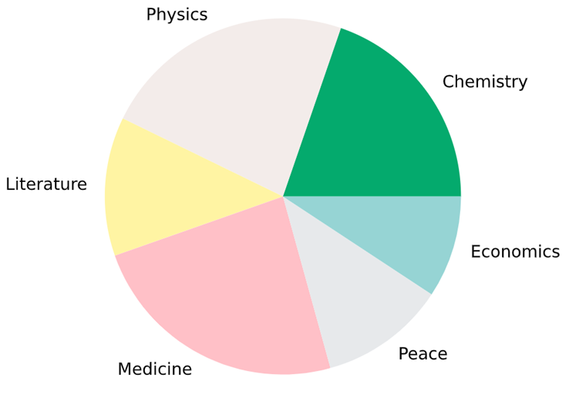
Idiom: Pie Chart
Data
1 categ key attrib, 1 quant value attrib
Derived Data: 1 quant value attrib (percentage)
Marks
Area (Wedges)
Channels
Tilt (Angle)
Color Hue
Task
Part-to-whole judgements

Slide 7
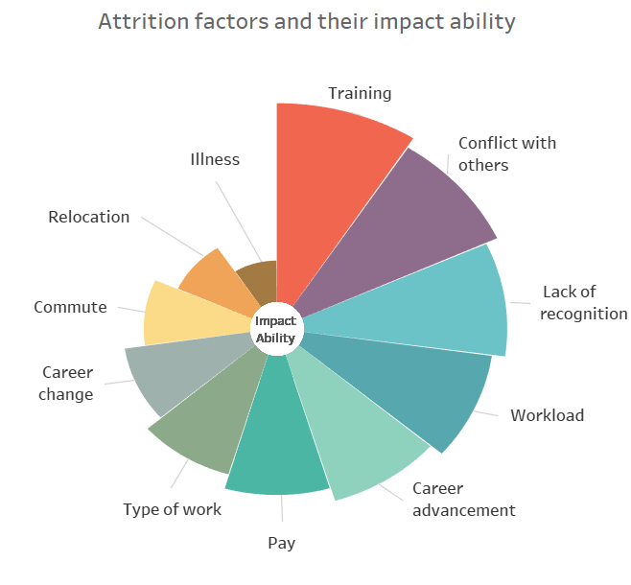
Idiom: Polar Area Chart (aka Coxcomb)
Data
1 categ key attrib, 1 quant value attrib
Marks
Area (Wedges)
Channels
Length of wedge
Color Hue
Task
Compare, lookup values

Slide 8


Data Visualization – Lecture 4 Quiz
Max Time Allowed: 10 Mins
Max Marks: 10
Open the form and be ready
Quiz will start after announcement
https://forms.gle/KhAviFghCuc8t8rf6

Slide 9
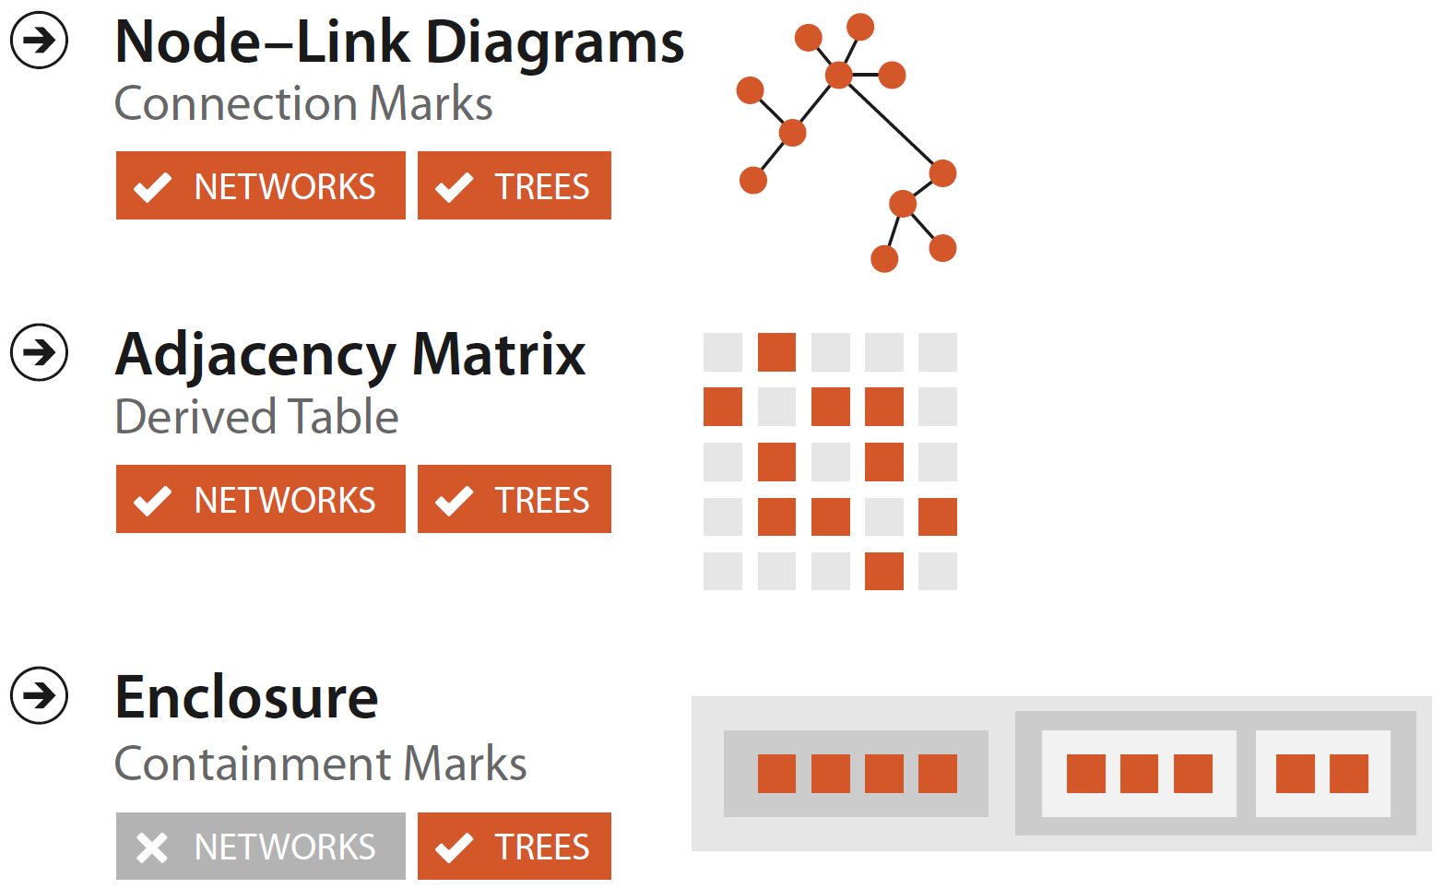
Networks and Trees

Slide 10
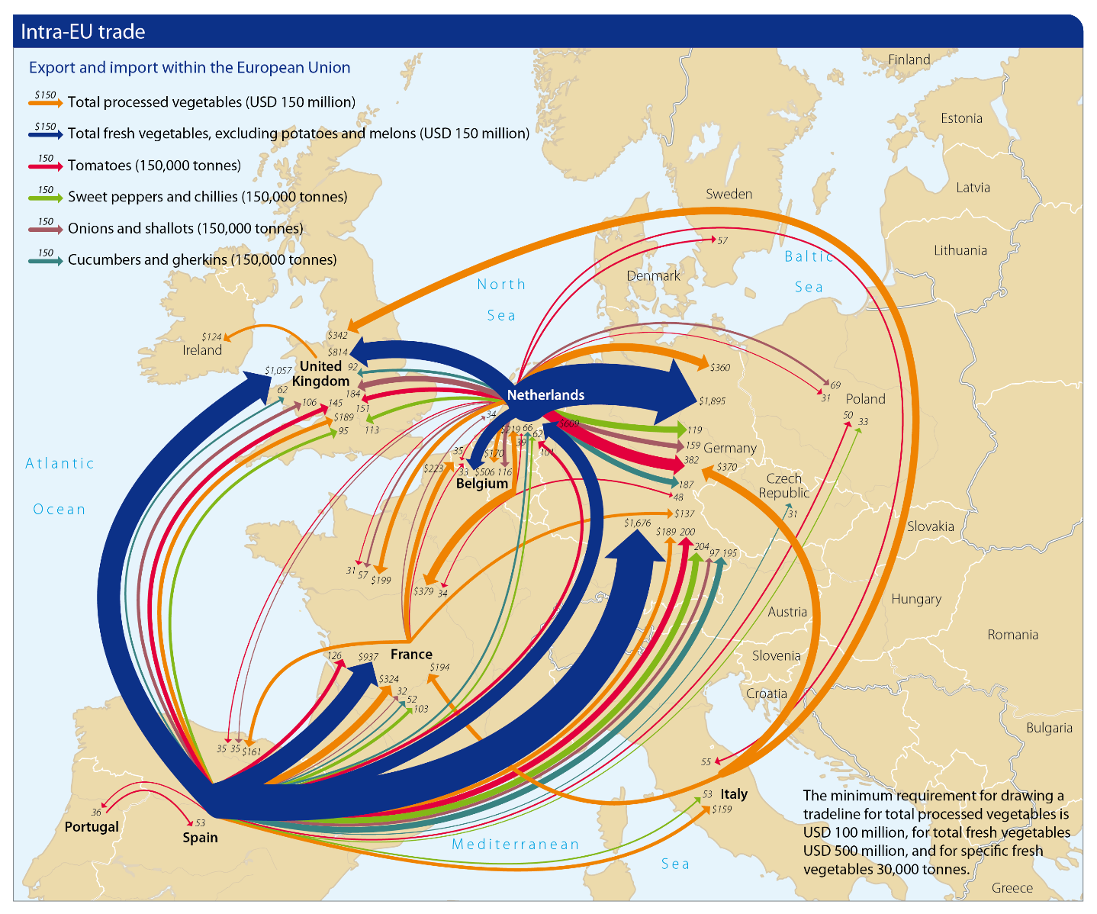
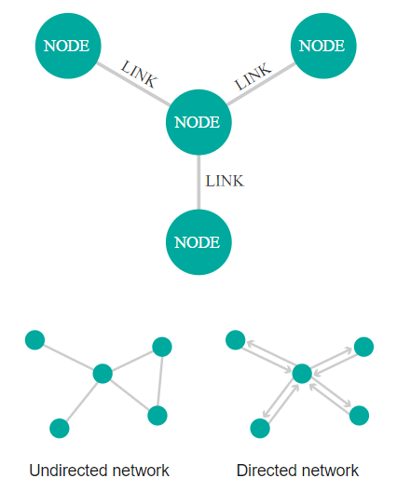
Node-Link Diagram
Anatomy
Export and import within Europe
https://research.rabobank.com/far/en/sectors/regional-food-agri/world_vegetable_map_2018.html

Slide 11
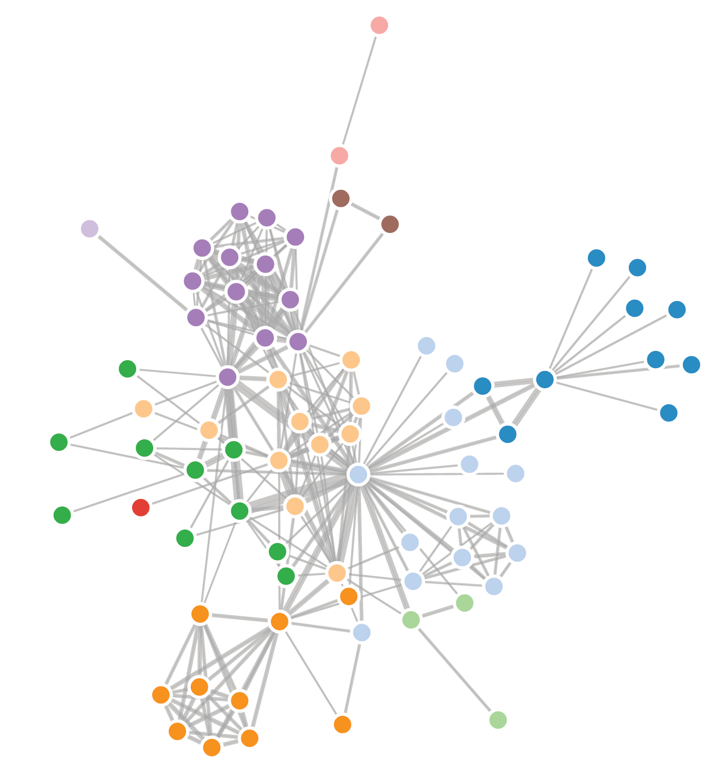
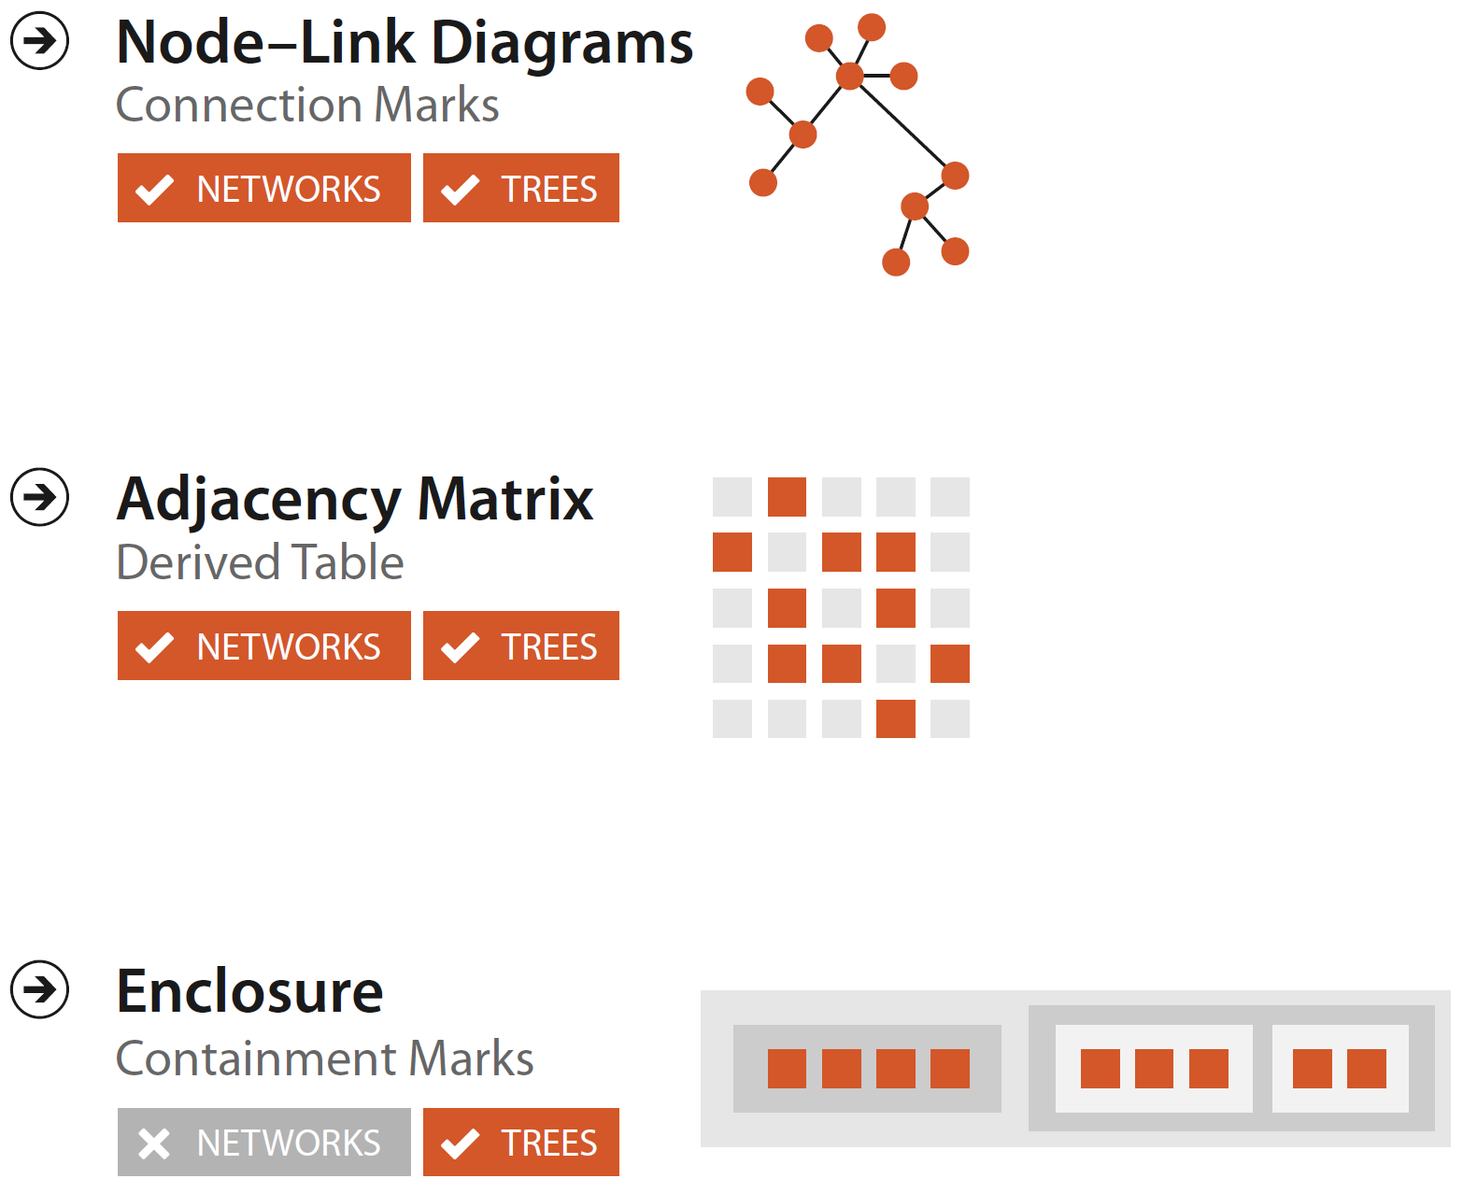
Idiom: Force-Directed Placement
Data
Network
Marks
Point (nodes), connection (links)
Channels
Spatial position: no meaning directly encoded
Non-deterministic, minimize crossings
Tasks
Explore topology; locate paths and clusters

Slide 12
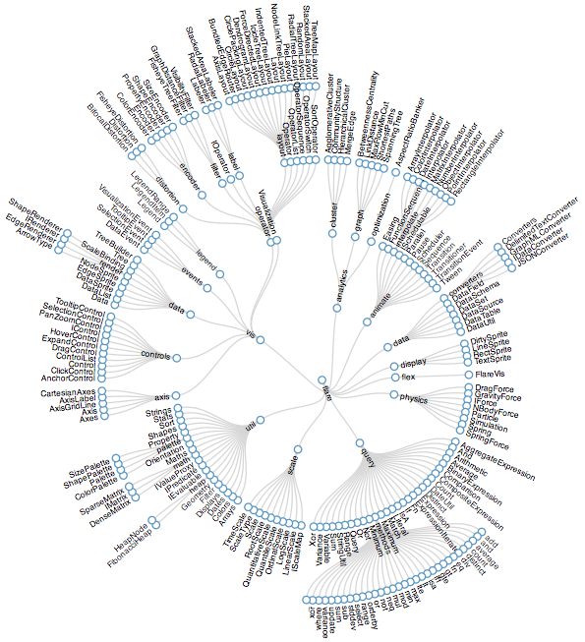
Idiom: Radial Node-Link Tree
Data
Tree
Marks
Point (nodes) + Connection (links)
Channels
Radial axis orientation
Position
Distance from center: Depth in tree/node level
Nodes at same distance from the center: Siblings
Tasks
Explore topology; identify paths and clusters

Slide 13
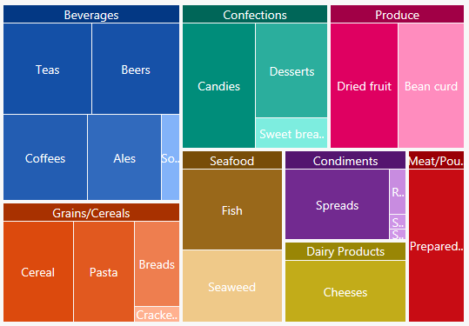
Idiom: Treemap
Data
Tree
Marks
Area + Containment for hierarchical structure
Channels
Rectilinear orientation
Area (2D Size)
Encodes a quant attrib of the node
Tasks
Summarize quantitative attribute at leaf nodes, Part-to-whole judgements

Slide 14
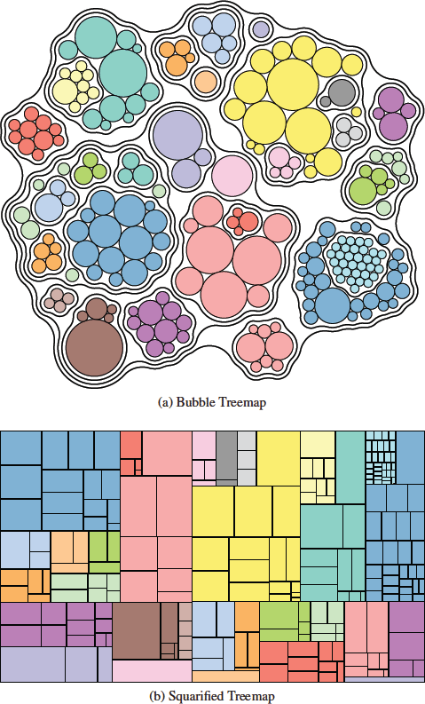
Treemap Variations
Squarified Treemaps
Bubble Treemaps

Slide 15
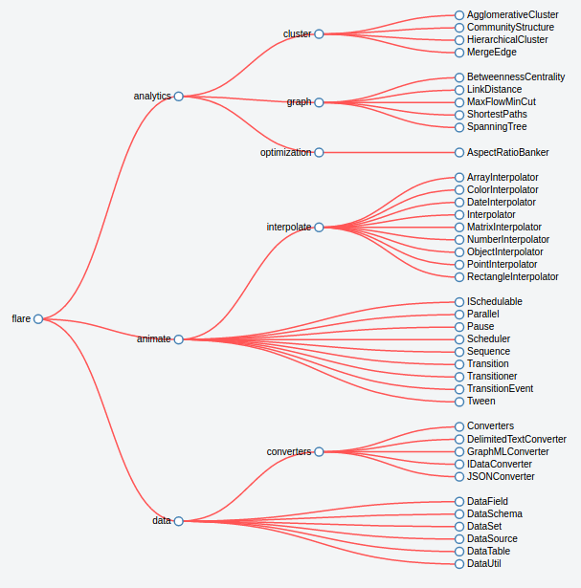
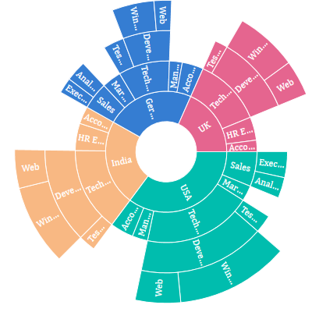
Additional Tree Layouts
Horizontal node–link tree
Sunburst chart

Slide 16
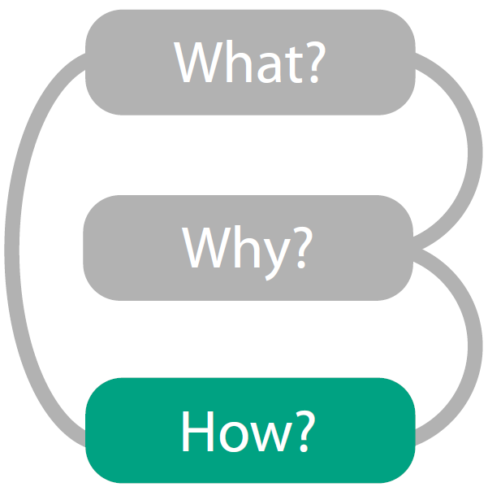
How? Interaction in Visualization

Slide 17
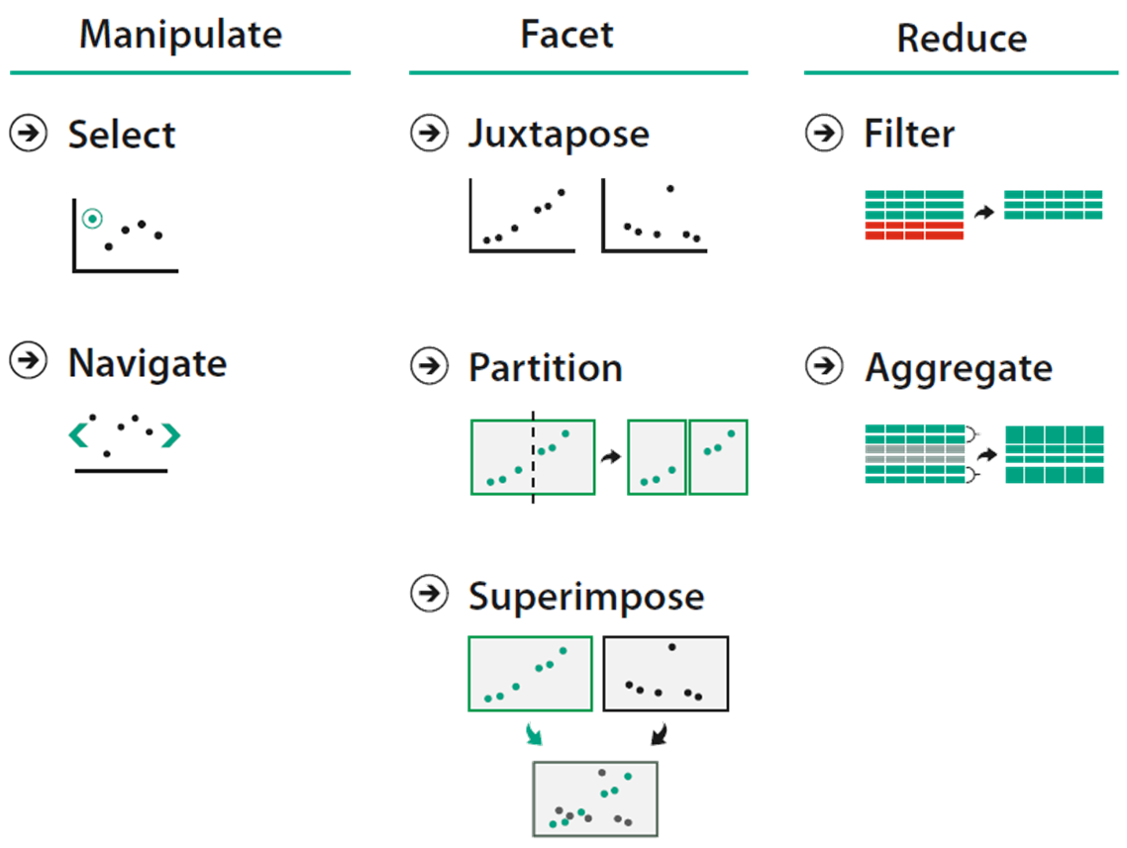
Interaction
Datasets are often large and complex
Need to handle complexity
Need for interactivity
How to interact with a vis?
Manipulate (change) view
Facet (split) across multiple views
Reduce items/attributes within single view

Slide 18
Interaction: Manipulate

Slide 19
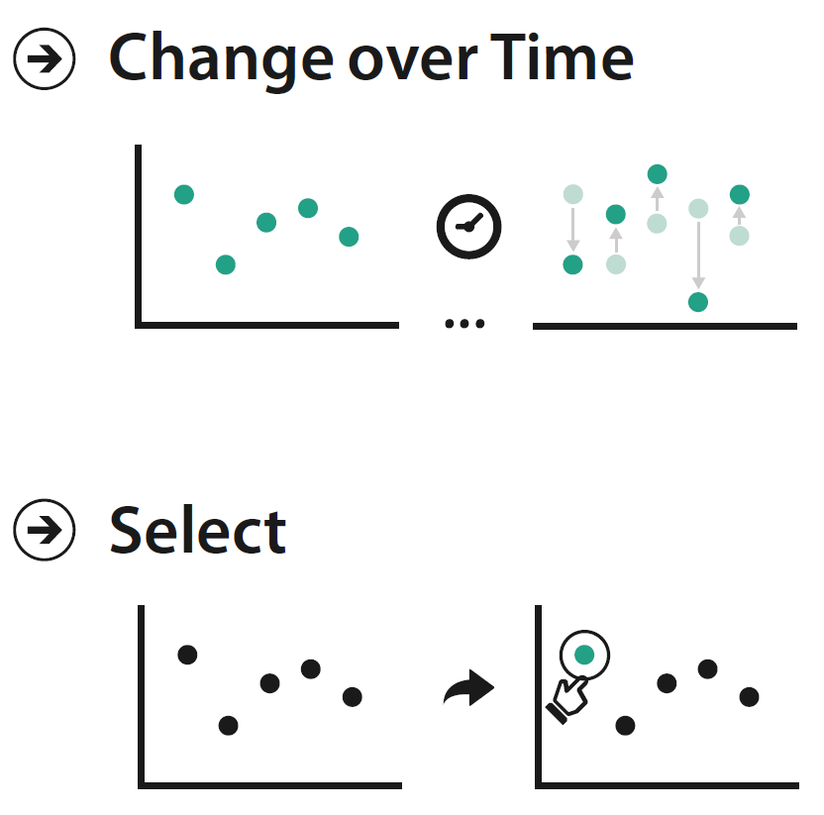
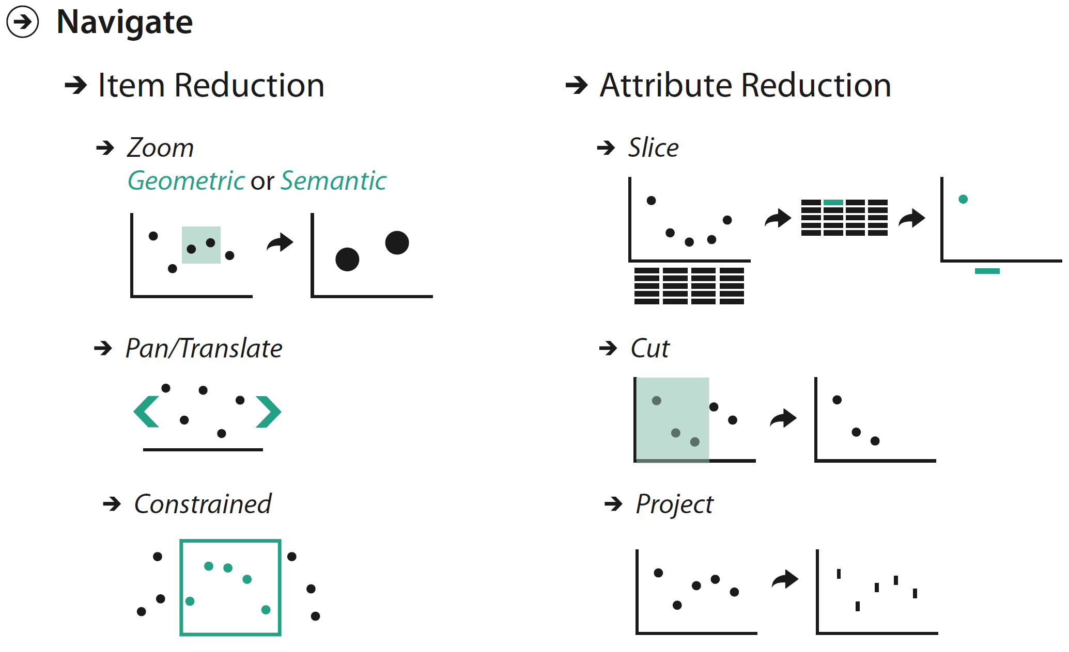
How to Manipulate a View

Slide 20
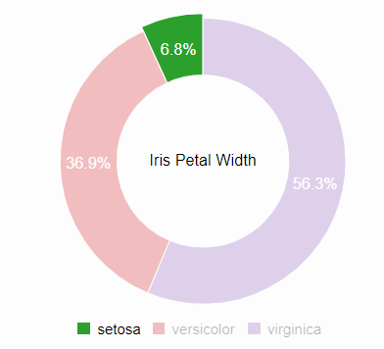
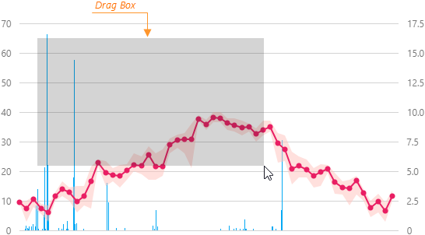
Select
Select action supports nearly every interactive idiom
Select one or more elements (data items, links, or attributes) of interest
Very closely tied to highlighting
Clicking
Hovering
Dragging and
selecting range

Slide 21
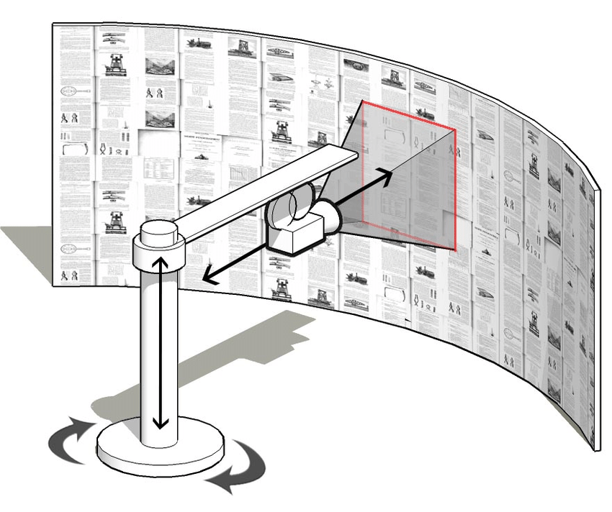
Navigate
Change viewpoint
Changes which items are visible within view
Camera metaphor
When the camera viewpoint is changed, the set of items visible in the camera frame also changes
Basic navigation techniques

Slide 22
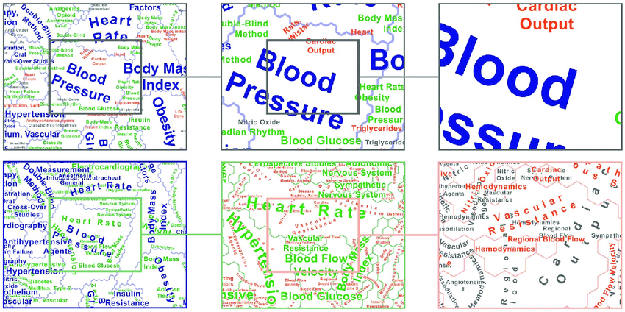
Basic Navigation Techniques – Zoom
Geometric Zooming
https://www.researchgate.net/publication/236105790_Visualizing_the_Topical_Structure_of_the_Medical_Sciences_A_Self-Organizing_Map_Approach/figures?lo=1
Semantic Zooming
Notes:
Examples
https://plotly.com/chart-studio-help/zoom-pan-hover-controls/
https://d3-graph-gallery.com/graph/interactivity_zoom.html

Slide 23
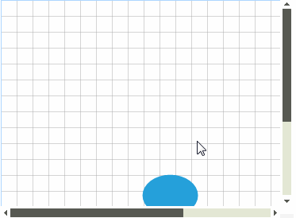
Basic Navigation Techniques
Pan/Translate
Moves viewpoint parallel to the plane of the image, either up and down or from side to side
Constrained Navigation
Some kind of limit on the possible viewpoints
E.g., limit the zoom range to 2x only
Panning
Notes:
Examples
https://plotly.com/chart-studio-help/zoom-pan-hover-controls/
https://d3-graph-gallery.com/graph/interactivity_zoom.html

Slide 24
How to Handle Complexity: Facet/Split

Slide 25
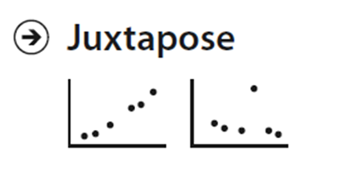
Juxtapose and Coordinate Views
Juxtapose views
Create side-by-side linked views
Why juxtapose views?
Benefits: Eyes vs memory
Lower cognitive load to move eyes between 2 views than remembering previous state with single changing view
Costs: Display area
2 views side by side each have only half the area of one view
Possible: Few dozen views with several hundred elements in each view

Slide 26
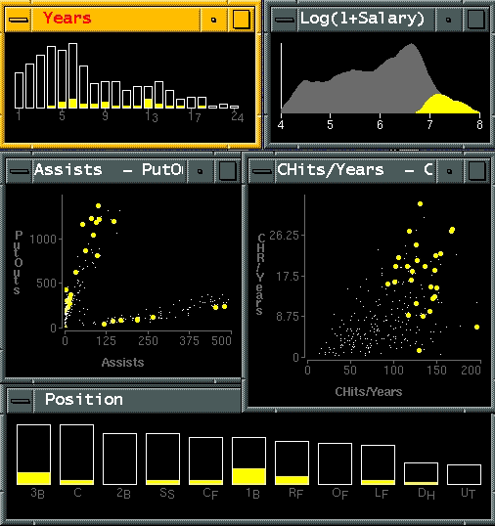
Idiom: Linked Highlighting
Interactively selected items are also highlighted in all other views
Same highlight color is used

Slide 27
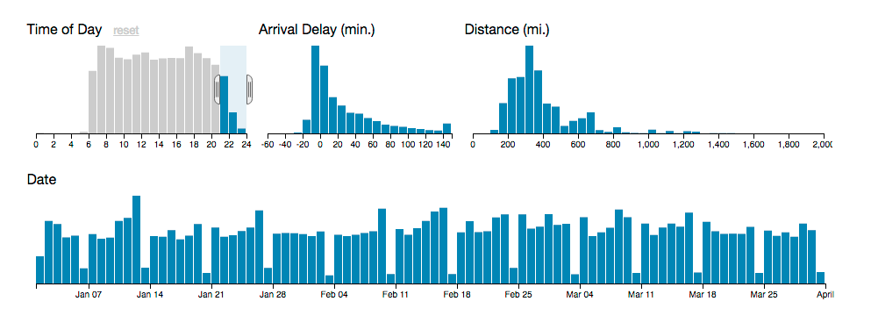
Idiom: Cross Filtering
Items filtered in one vis are also filtered from all other linked views
http://square.github.io/crossfilter/

Slide 28
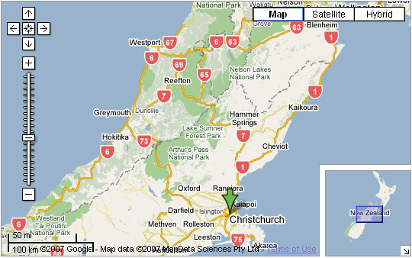
Idiom: Bird’s-eye Maps
Map views with a smaller bird’s-eye overview window in addition to a larger detail view

Slide 29
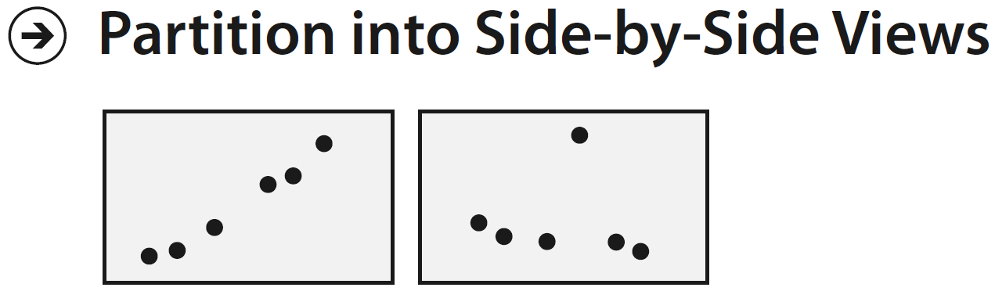
Partition into Views
How to divide data items between views
Has major implications for what patterns are visible
Split according to attributes
Design choices
How many splits
Order in which attributes used to split
How many views

Slide 30
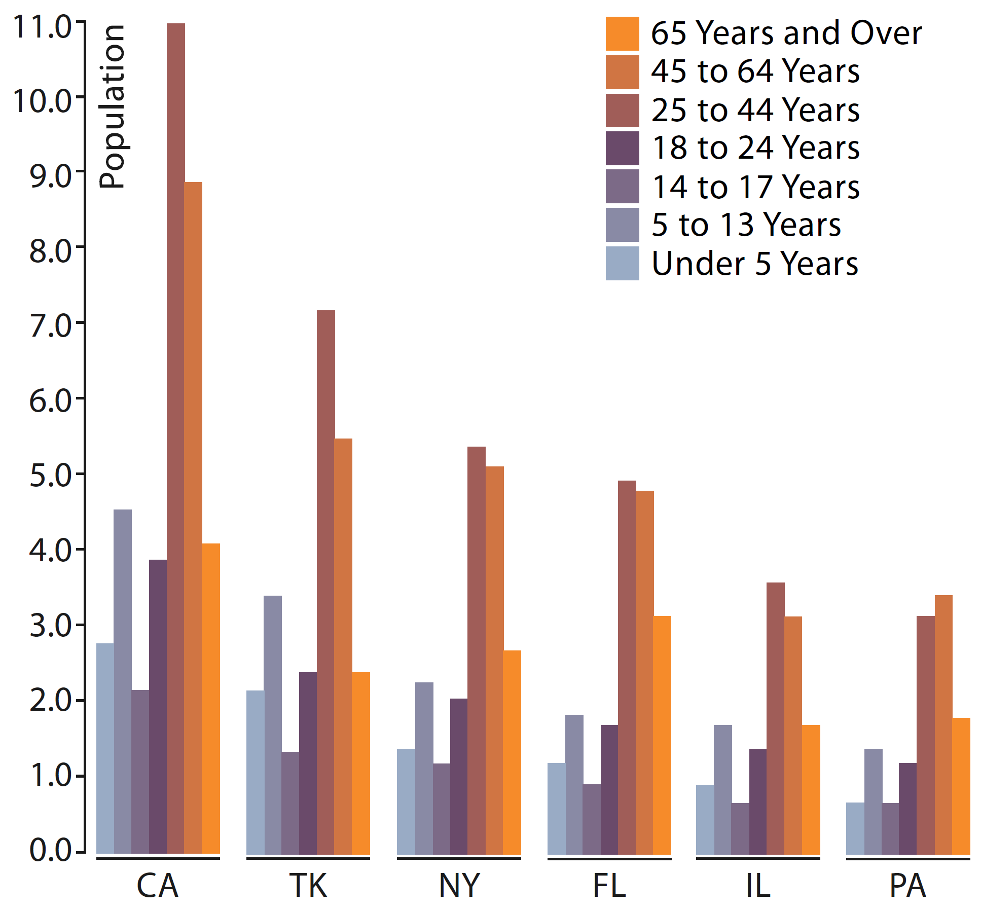
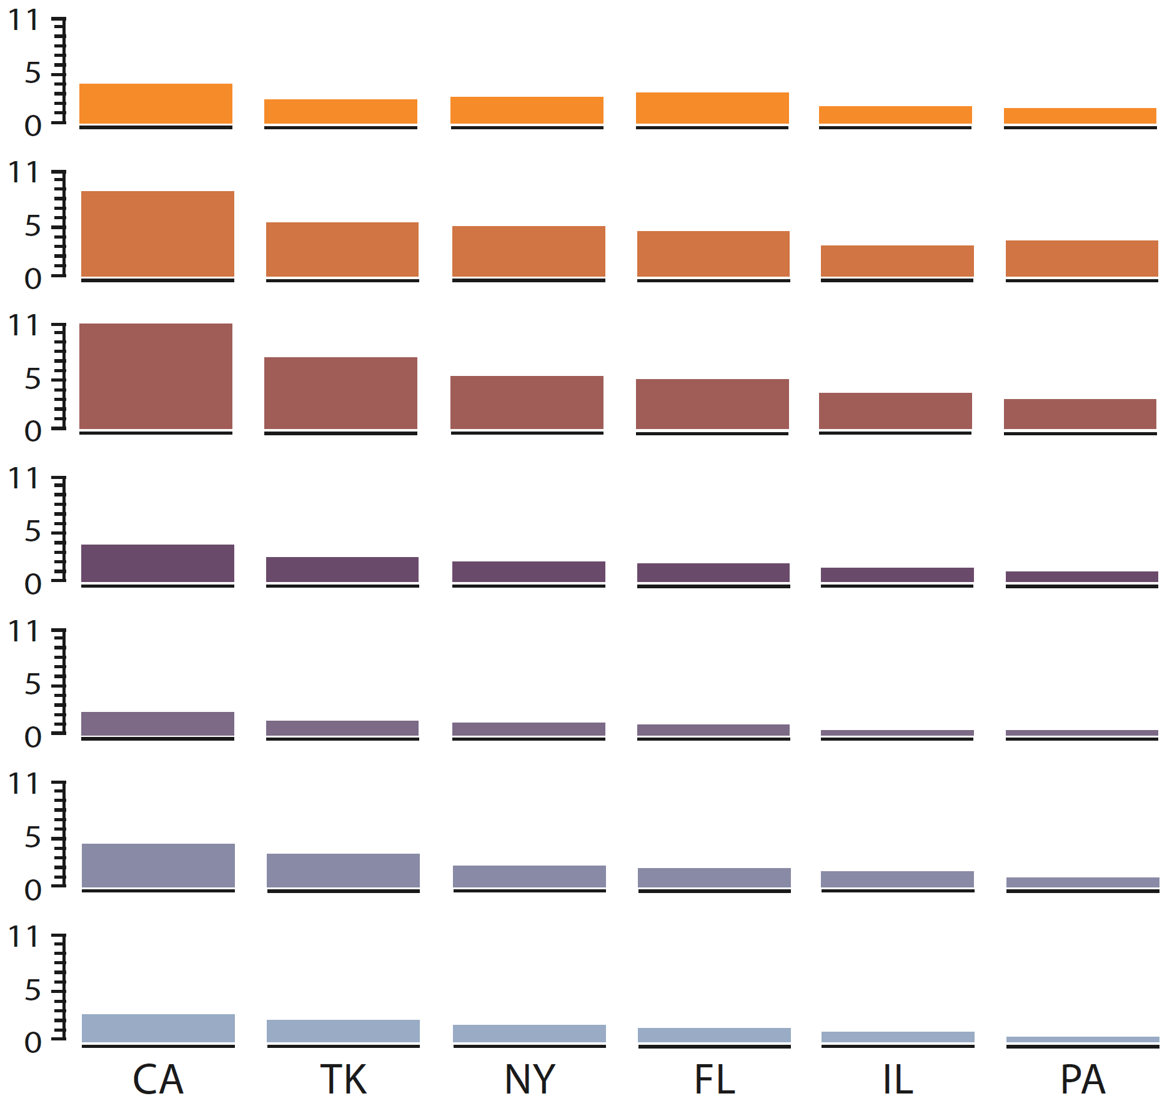
Partitioning – Grouped Bar Chart
Single bar chart with grouped bars
Split by state into regions
Complex glyph within each region showing all ages
Compare: Easy within state, hard across ages
Small-multiple bar charts
Split by state and age into regions
Different charts per region
Compare: Easy within age

Slide 31
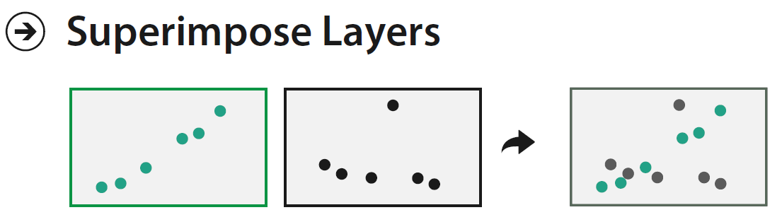
Superimpose Layers
Combine multiple layers together by stacking them directly on top of each other in a single composite view
Layer: Set of objects spread out over region
Each set is visually distinguishable group
Layers can be shown as juxtaposed side by side views

Slide 32
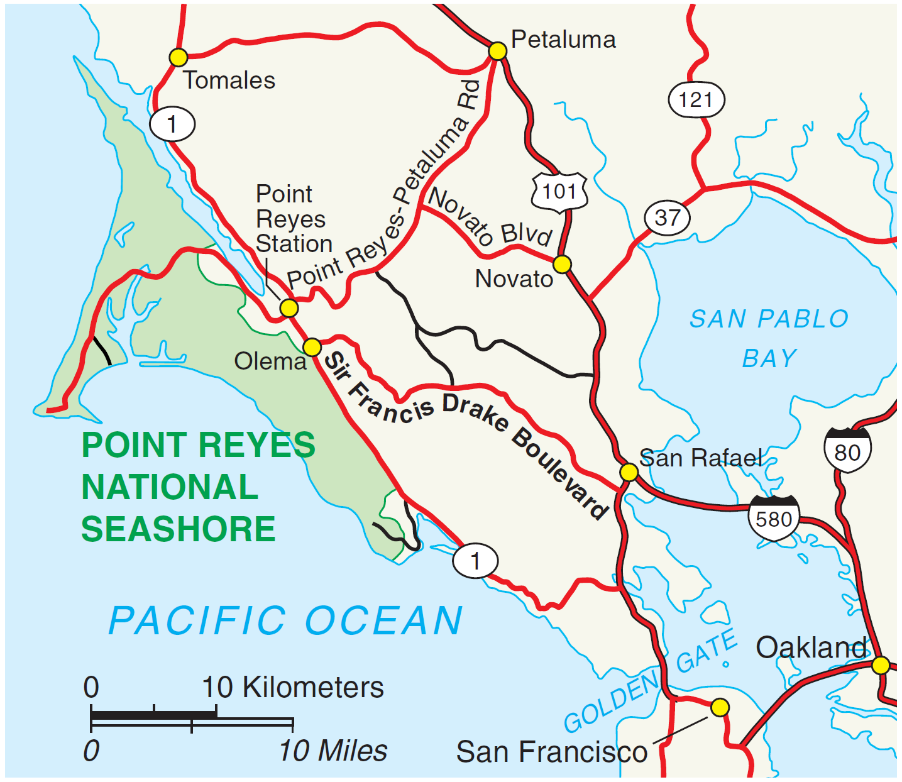
Visual Layering in Maps
Foreground layer: Roads
Marks: Lines
Channels:
Hue
Size distinguishing main from minor
High luminance contrast from background
Background layer: Regions
Marks: Area
Channels:
Desaturated colors for water, parks, land areas

Slide 33
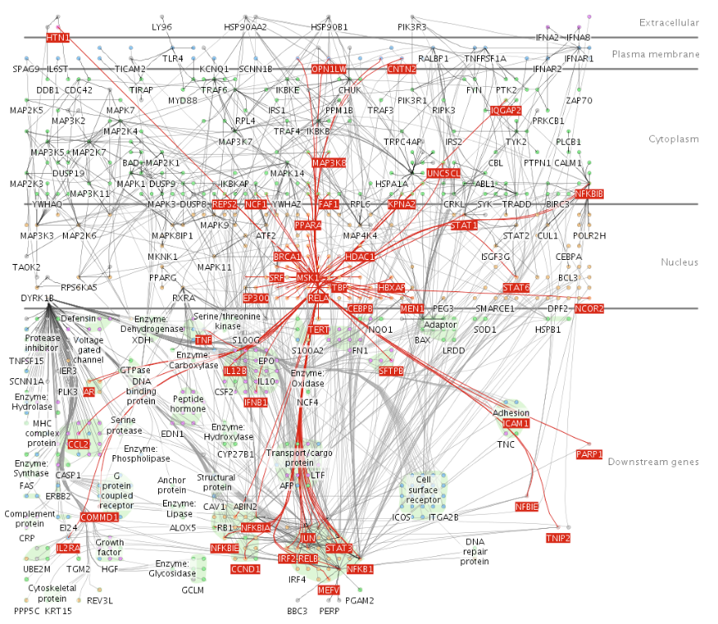
Superimpose Layers - Examples
Background layer
Static network topology
Foreground layer
Dynamically created when mouse hover on a node
One topological hop away nodes are highlighted in red

Slide 34
How to Handle Complexity: Reduce

Slide 35
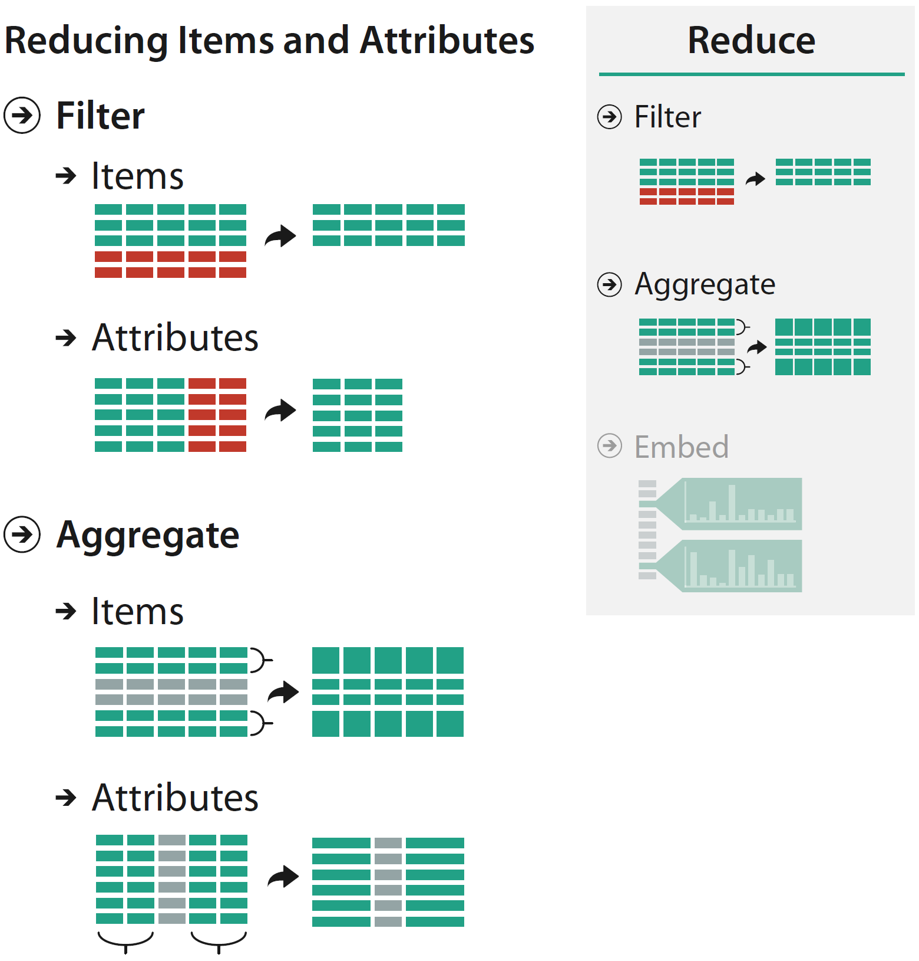
Reduce Items and Attributes
Reduce what is shown at once within a view
Filter
Eliminates elements (items or attributes)
Visual encoding of the dataset is used in conjunction with controls (e.g., sliders, buttons, dropdowns, text fields)
Aggregate
Combine many elements (items or attributes) together to derive new elements

Slide 36
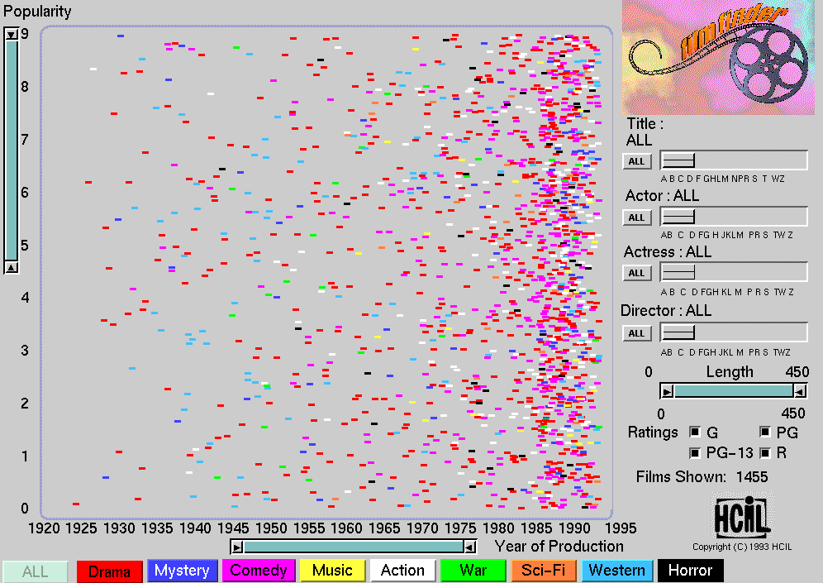
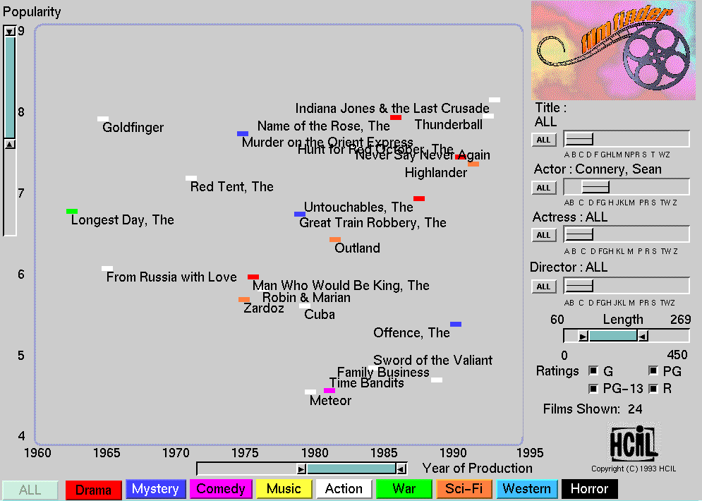
Filter Example - Film Finder system
[System: FilmFinder]

Slide 37
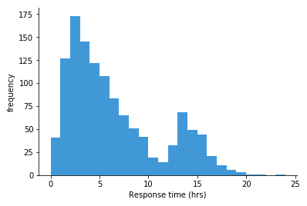
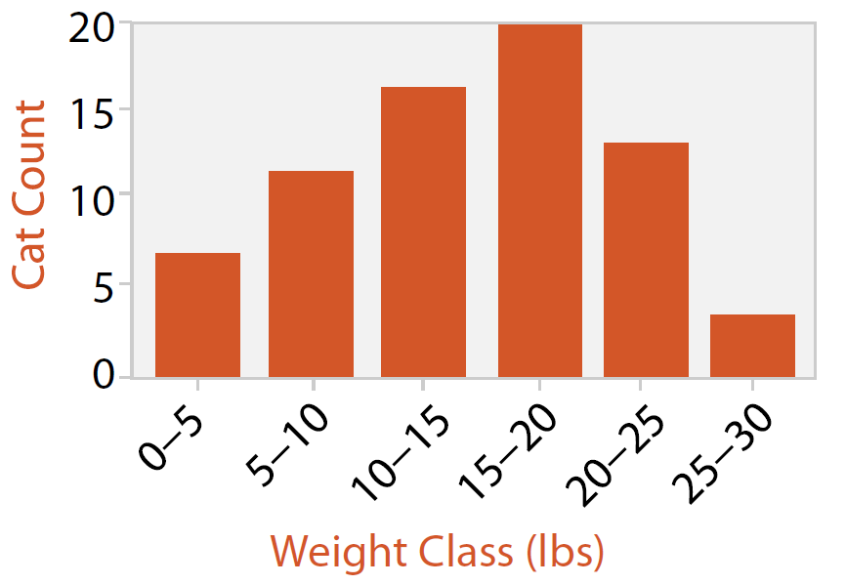
Idiom: Histogram
Data
1 quant value attribute
Derived data (item aggregation)
1 ordinal key attribute (bins)
1 quant value attribute (frequency)
Marks
Lines
Channels
Spatial regions: One bin per mark
Length to represent frequency
Task
Show the distribution of items

Slide 38
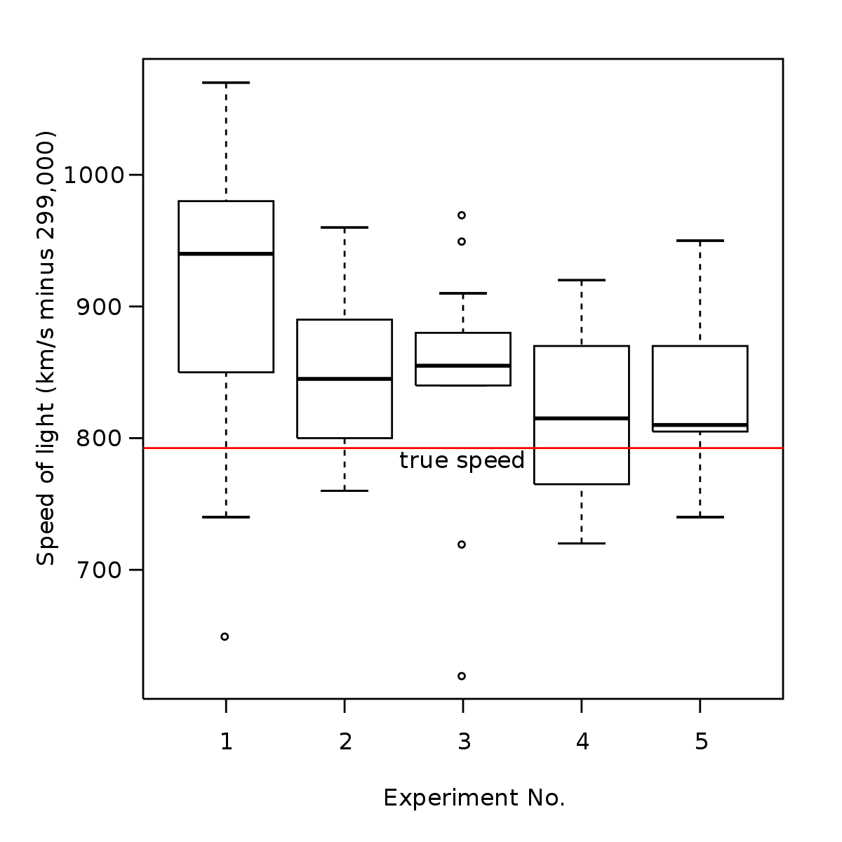
Idiom: Box Plot / Box and Whisker Plot
Data
n quant value attribute
Derived data (item aggregation)
5 quant attribs for each original quant attribute
Median: Central line
Lower and upper quartile: Boxes
Lower and upper fences
Outliers beyond fence cutoffs explicitly shown
Marks
Glyph: horizontal combination of line marks
Channels
Spatial regions: One per glyph
Each glyph represent one quant value attribute
Position on common scale of 5 derived attributes
Task
Identify distribution of items, outliers

Slide 39
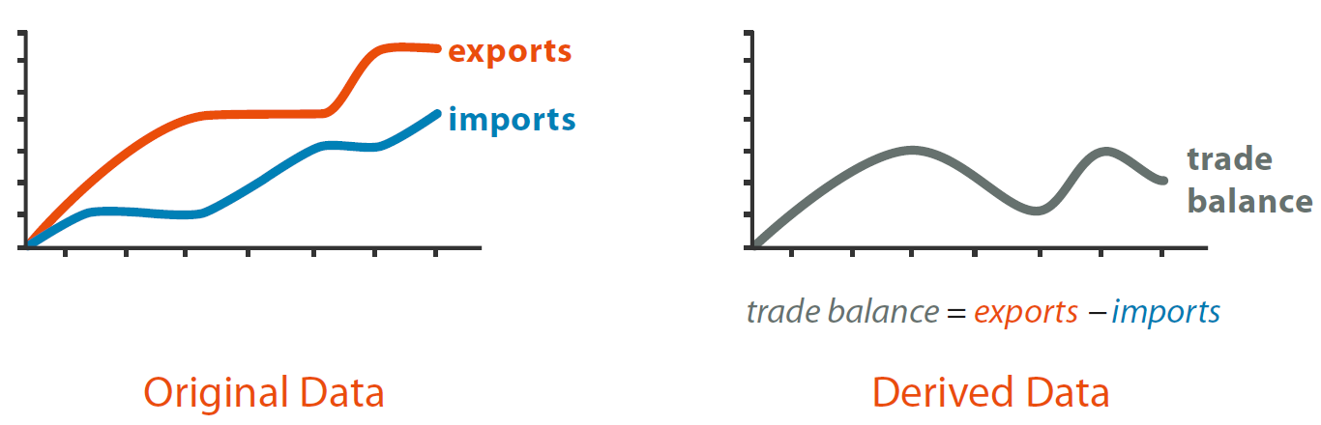
Example – Attribute Aggregation
Two quantitative value attributes
One aggregated (derived) quantitative value attribute

Slide 40
Guidelines – Rules of Thumb

Slide 41

Guidelines – Rules of Thumb
No unjustified 3D
Our depth judgement/perception is less accurate than length perception
Eyes beat memory
External cognition vs. Internal memory
Interactivity Mantras
Overview first, zoom and filter, details on demand (Shneiderman, 1996)
Analyze First - Show the Important - Zoom, Filter and Analyze Further - Details on Demand (Keim et al., 2008)
Responsiveness is required
Need for visual feedback: Confirmation that the action has completed
Get it right in black and white (grayscale)
Function first, look-and-feel next

Slide 42




Good Design Choices – Colors
Luminance: The number of discriminable steps (bins) is small (typically <5)
Avoid grayscale if more than three bins are required
Saturation: The number of discriminable steps is low (around 3 bins)
Nonadjacent small regions of color: Only 6-12 bins including background and highlights

